Slide 1
Mobile SDK Design
- Playback 1 (20-Jan-2014)

Slide 2
Agenda
Project Goals Review
  Vision for Mobile SDK
  Playback 1 Goals
Playback 1 Deliverables
  Demo
Project Challenges & Recommendations
Playback Roadmap
Q&A

Slide 3
Project Goals Review
IBM should provide a toolkit to our customers and business partners that will enable them to develop Cúram mobile applications
Playback 1 Goals
  User story: Ability to develop a mobile application that reads data from Cúram
    Demo a simple end to end scenario, via a simulated Worklight mobile application retrieving data from Cúram
  Architecture Prototyping to mitigate technical risks
    Understand Worklight marketplace for packaging and delivery integration
    Prototype Worklight/WebSphere security integration
    Investigate improvement of development environment experience
Notes:
Playback Zero (16-Sep-2013)
Playback 1 due 17/12 : assuming 8 weeks development with 5 developers. Actually began in Nov and had 2.5 developers with allot of L3 context switching.

Slide 4

Playback 1 View
Application Server
Dojo
List
Widget
Data Service
Layer Servlet
Web Client
Cúram Facade
Text
Helper
Cúram CDSL
Database
MCoC Core Framework
Worklight APIs
Worklight Server
Cúram WL Adapter

Slide 5

Karl – Mobile Application Developer
Goal: Ability to develop a mobile application that reads data from Cúram
Demo highlights:
  Aligned with existing Cúram development patterns
  Abstracts the complexity of retrieving data from Cúram, by allowing simple integration with dojo widgets
  Allows developer to focus on data presentation and mobile function
Notes:
Demonstrates simplicity of connecting a dojo widget to Cúram
Familiar for existing Cúram developers

Slide 6
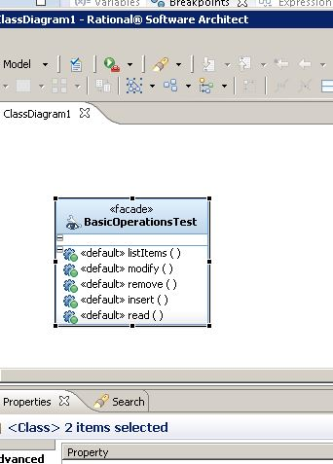
Cúram Development
Using the standard Cúram modelling and development environment, Karl develops a façade: BasicOperationsTest
He builds his project, as per standard Cúram development
Notes:
Demonstrates simplicity of connecting a dojo widget to Curam

Slide 7
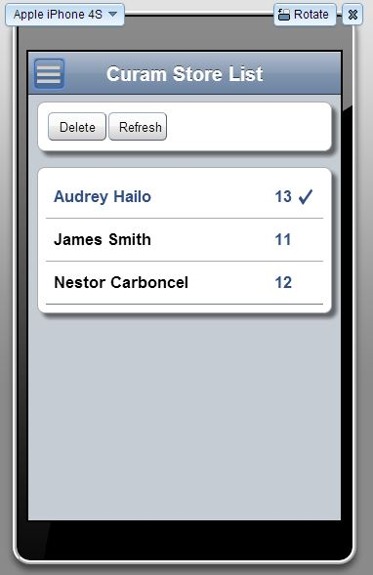
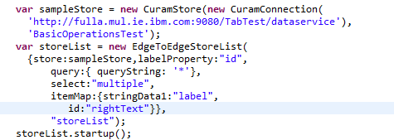
Worklight Development
In Worklight, Karl creates the configuration files and project structure inline with MCoC Core Framework
Karl develops a list view page using a dojo mobile widget
He connects to his facade using the Cúram Data Service Layer APIs
Notes:
Demonstrates simplicity of connecting a dojo widget to Cúram
CDSL uses a standard dojo data pattern, allowing it to be easily integrated with widgets that observe this pattern.
The simplicity for Karl here is that connecting the dojo list widget to call and retrieve data from Cúram is simply three lines of code.

Slide 8
Playback 1 : Deliverables and Outstanding
Delivered
Cúram Data Service Layer
  Abstracts the data handling complexity
  Provides ability to access Cúram data in form that is suitable for consumption on mobile devices
  Full CRUD support
  10 out of 13 raw data types supported
Worklight Sample Application
Starter Documentation
Outstanding
Architecture Prototyping to mitigate technical risks
  Understand Worklight marketplace for packaging and delivery integration
  Prototype Worklight/WebSphere security integration
  Investigate improvement of development environment experience
Notes:
Codetable , Date and Datetime – chosen as deemed the most complex and most used formats
Priority given to Care Coordination
Not delivered: Time, blob and frequency pattern
Not started: due to limited resources

Slide 9
Project Challenges and Recommendations
Challenges
  Reduced resources due to Arabic and HCR project support
  Project currently behind schedule
    January 2015 current projection for full feature completion
Mitigation options considered
  Descope features from mobile project for 6.1, with phased delivery post June
    Notable features: pagination, offline and production support
  Add required resources to meet current 6.1 deadline
    5 fulltime additional resources
Recommendation
  Post 6.1 phased delivery of descoped features.
Notes:
Original Plan:
Project team of 7 : mid sep to end Feb, with doc and sample running beyond this to end march 2014
Playback 0: 16th September
Due to start Playback 1: October – delayed due to sev 1 support cases, started end October
Playback 1: 3 resources for 7 weeks
Expected to b: 8 weeks from project start (assumes 5 developers)

Slide 10
Playback Roadmap
Playback 2 : March 31st
  Architecture Prototyping to mitigate technical risks
  Extended CDSL Functionality
  RSA modelling support and integration for mobile facades
Playback 3 : June 31st (6.1 Delivery)
  Mobile SDK starter framework
    suitable for initial development of mobile applications – non production
Playback 4 : September 2014
  Production Support
  Pagination
Playback 5: December 2014
  Offline

Slide 11
Questions?

Slide 12
Appendix

Slide 13

Architecture Diagram
Application Server
Cúram
Server
UIM
Web Client
Facade
Traditional Cúram
Text
Helper
Data Service
Layer Servlet
Cúram
Hybrid
Mobile App
Database
Cúram Mobile APIs
Worklight Server
Cúram WL Adapter
MCoC Core Framework
Worklight APIs

Slide 14
Project Risks – highlighted in Playback 0
Worklight does not support WebLogic
  Mobile first strategy means relying on MCoC Core Framework and Worklight
  As a result sample application is not applicable to WebLogic customers
Mobile Center of Competency (MCoC) Integration Concerns
  Immature products; Bleeding edge integration
  MCoC content included as part of Cúram delivery
Worklight/Eclipse Usability
  Performance concerns running with full Cúram and Worklight in Eclipse
  Worklight experience not as user friendly as iOS development
Customer Expectations
  Need to develop mobile specific facades
  Mobile expertise required
  Level of Support
Resourcing
  All resources not confirmed
  However a minimum deliverable is achievable
Notes:
Weblogic is not supported by WorkLight- and number of our large customers are on Weblogic (NY, MSD, Washington DC)
“Aligning to mobile first strategy means relying on MCoC Core Framework and WorkLight as part of the mobile stack”
This means however that “WebLogic customers will not get the same collateral.” as their blue stack counterparts. Specifically the sample application delivered will not be suitable for reuse OOTB.
<skip forward slide to diagram >
Outside of facades that underpin sample we are not delivering production ready mobile facades
Our Existing facades are not mobile suitable – missing key attributes not db secure and return too much data
Volume of (approx 20k) facades in application means predicting what customer will use
Concern here is that customers will except a level of support on their custom developed app
************************************************************************************************************************************************
“To support WebLogic customers to the same level, we discussed the possibility of creating a second WorkLight independent sample application. However”
Mobile first initiative has a high backing and while the current collateral is low this will grow and it will be virtually impossible for us to keep the second offering aligned with a IBM wide backed delivery.
Also workLight is only one of a range of products in this space. Determining upfront what tool a customer may choose to use, would be difficult, and for any that don’t align with our choice, negate the value of the alternative sample.
The other option reviewed was to package the solution as two independent elements: 1) Curam Data Service Layer and 2) Worklight sample application.

Slide 15
Third Party Glossary
Worklight Studio
  An Eclipse plugin supporting the development of mobile applications
  Provides simulation environment for testing mobile applications
Worklight MarketPlace
  A Eclipse based plugin framework for additional utilities to support creating mobile applications
Worklight Server
  The Worklight production environment supporting enterprise features such as security, analytics and device provisioning
Mobile Center of Competency (MCoC) Core Framework
  A Worklight component providing a standard best practice base for creating mobile applications
  Supports additional UI components

